Slide 1


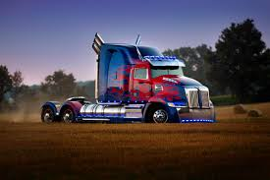
BUAN 6346 Big Data The Truck Driver Risk Factor Project
Group5:
Aditya Bairagi
Rhea D’souza
Harshit Gupta
Anchal Jain
Palash Jain
Pei-Wen Liu
Rasika Pawar

Slide 2
PROBLEM STATEMENS AND OBJECTIVES
Business Problems
Ensure all the truck drivers follow the corporate regulations and do not present an insurance risk.
Data Processing
Manipulate data by using tools of data ingestion[put command], data processing[Hive, Impala], data analysis[R], and data visualization[Tableau].
Analytics Report
Create analytics reports and visual presentation that will provide information to highlight the risk factor to each driver.

Slide 3









WORKFLOW DIAGRAM
Files Downloaded from elearning to Local
Data Visualization
Predictive analytics using R
Truck.csv and geolocation.csv are loaded to VM
Data Processing:
Create tables in Hive/Impala using DDL
Execute pig script to generate risk factor table
Data analysis and exploration:
Generate visualizations in tableau
Load local files into HDFC

Slide 4
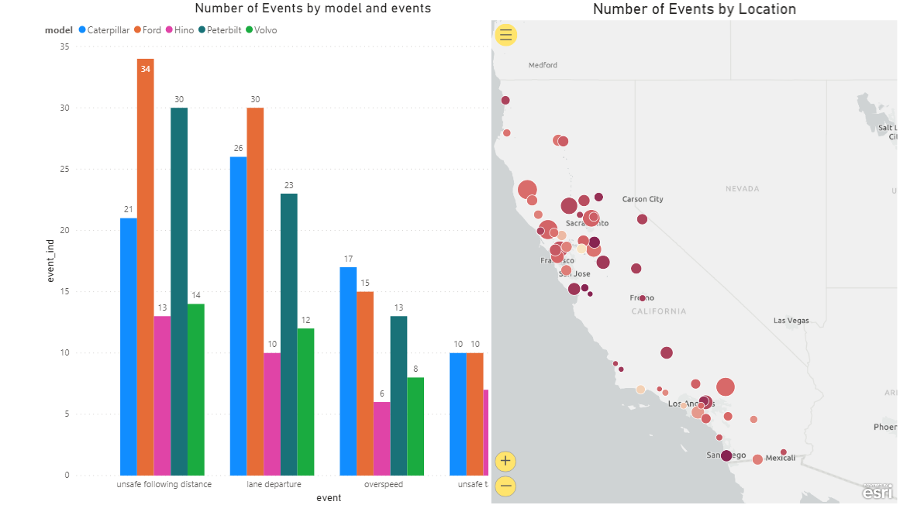
Events by Trucks Model and Location
https://cometmail-my.sharepoint.com/:p:/g/personal/hxg190019_utdallas_edu/Ea3-NxkCRU1IseMDOK62gLgBagP_5z37n870cTDfkWe9cg
Ford model has most no of events in every category.
Santa Rosa has the highest events

Slide 5
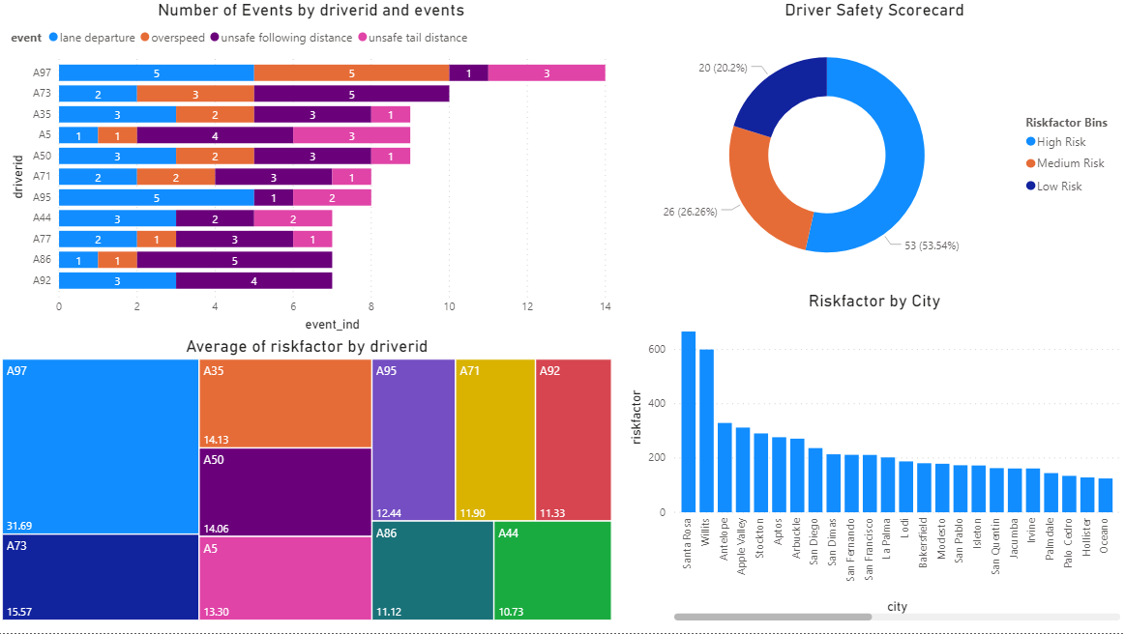
DRIVER ANALYSIS
Santa Rosa has the highest no of risky drivers.
53.54% of drivers comes under high riskfactor in California.
A97 has maximum no of events in comparison with other drivers i.e 11

Slide 6
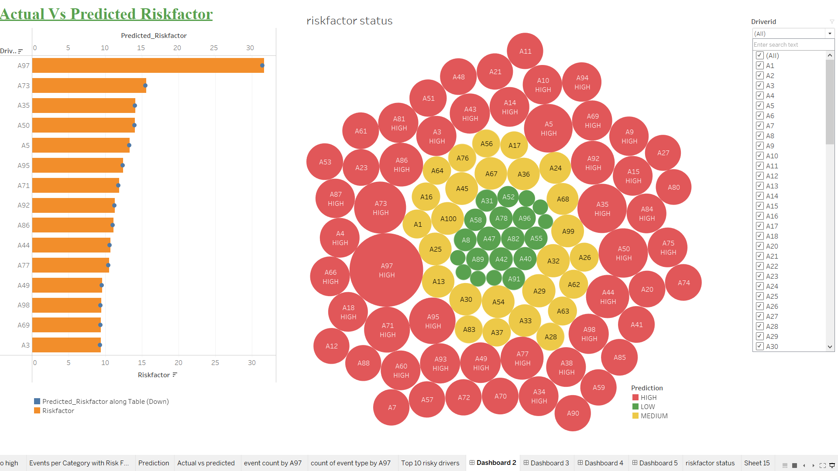
LINEAR REGRESSION PREDICTION
We ran linear regression to predict the riskfactor of drivers
The actual riskfactor and predicted riskfactor are very close that implies our model has high accuracy.
Driver A97 has the highest riskfactor.

Slide 7
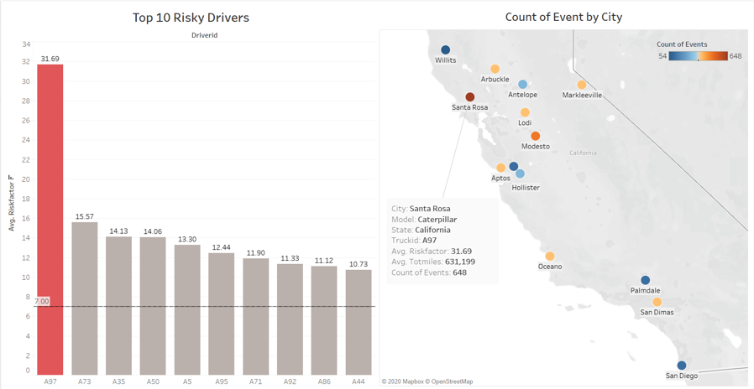
Key Insights
After analysing the data we found that:
Driver Id A97 had the Average risk factor of 31.69 and according to our model the average riskfactor is 31.29
He has travelled on an average 631.2 miles in California majorly in Santa Rosa City.
A97 Driver is using Caterpillar model

Slide 8
Conclusion
We should always check the riskfactor of driver and if driver comes under High category then system will give a warning.
There should be a general warning in all cities especially in Santa Rosa about the driver 97, that has the highest average riskfactor.

Slide 9
